Slide 1
Knowledge and Reasoning

Slide 2
Objectives
Knowledge Representation
Propositional Logic
Rules of Inference
Wumpus World Example

Slide 3
Knowledge Representation
Knowledge is defined as "The act or state of knowing; clear perception of fact, truth or duty; certain apprehension." [Webster Dictionary]
Knowledge in AI is represented using a formal language
The formal language enables AI programs to perform reasoning and logical inferences
Knowledge-based Agents
  “agents that reason by operating on internal representations of knowledge”
Notes:
Knowledge-based agents are those agents who have the capability of maintaining an internal state of knowledge, reason over that knowledge, update their knowledge after observations and take actions. These agents can represent the world with some formal representation and act intelligently

Slide 4
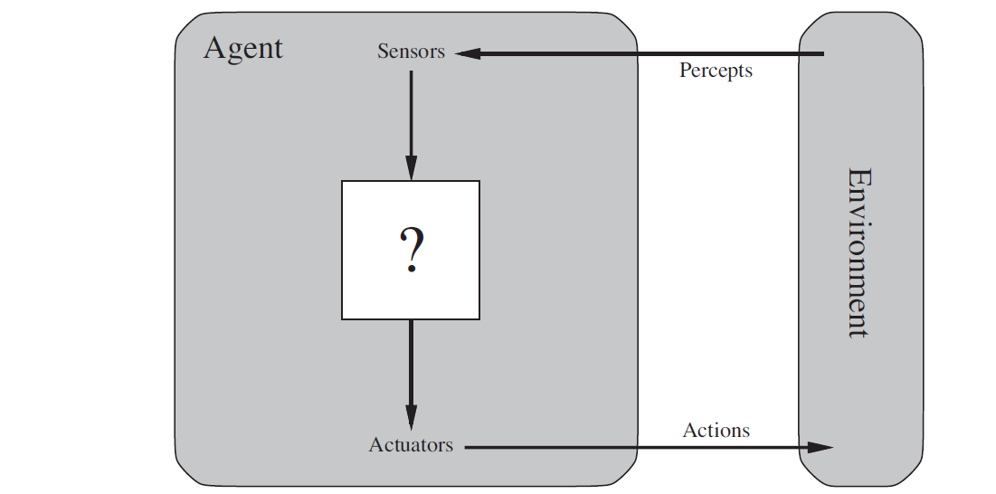
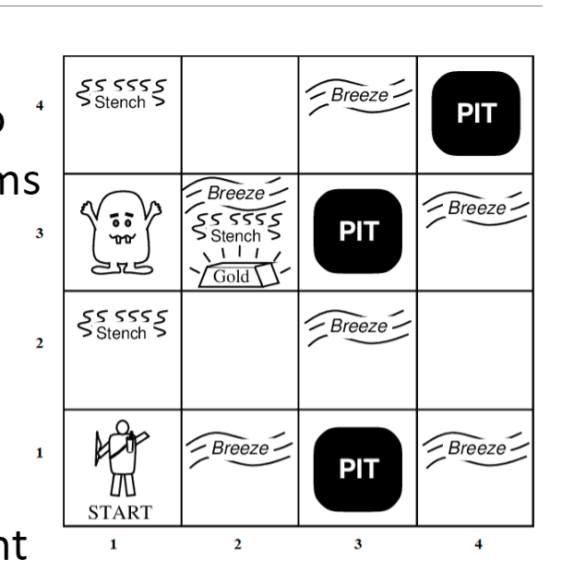
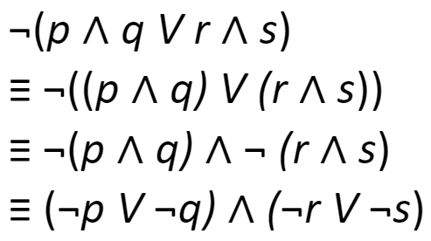
Logic-Based Agent
Using Logic to represent the environment (world), perceive the environment and take rational actions.
Representing knowledge
Reasoning

Slide 5
Knowledge Representation
The representation (formal) language has the following important attributes:
  Syntax:
    how legal sentences are constructed
    which symbols can be used and how to write those symbols
    So that an agent can distinguish the correct structure from the incorrect one.
  Semantics:
    defines the meaning of a sentence, or rules by which a logic sentence is interpreted
    assigns a meaning to each sentence; a value true (T) or false (F)
  Inference Rules:
    The rules of logic inference (manipulation)

Slide 6
Requirements of Knowledge Representation
A good knowledge representation system must have properties such as:
Adequacy of Representation:
  It should represent all kinds of knowledge needed in the concerned AI-based system.
Adequacy of Inference:
  It should be able to manipulate the representational structures to produce new knowledge corresponding to the existing structure.
  All that can be inferable by manipulating the given knowledge structures should be inferred by the system when needed.

Slide 7
Requirements of Knowledge Representation
Inference Efficiency:
  The knowledge structures in the representation are organized so that the inferential knowledge mechanism (deductions) navigates into the most productive direction and reach the goal quickly.
Efficient Acquisition:
  It should be able to acquire the new information automatically and efficiently, as and when needed, and also update the knowledge regularly.
Notes:
Inferential knowledge approach represents knowledge in the form of formal logics.
This approach can be used to derive more facts

Slide 8
Mathematical Logic
A tool for working with compound statements, which includes:
  a formal language for expressing compound statements
  a concise notation for writing compound statements
  a methodology for objectively reasoning about the truth or falsity of the compound statements
The foundation for expressing formal proofs in all branches of mathematics.

Slide 9
Logic Foundations
We study logic because of the following reasons:
Logic deals with what follows from what?
    Example: logical consequence, inference pattern, and validation of such patterns
We want to represent knowledge such that:
  A computer can understand our language and/or perform some intelligent tasks
  Identify which statement has/is a fallacious argument and what is the type of fallacy
  Prove theorems through deduction; to find out whether whatever is proved is correct, or whatever is obviously true has a proof.
  Solve some problems concerning the foundations of mathematics

Slide 10
Propositional Logic
Propositional Logic is the logic of compound statements built from simpler statements using so-called Boolean connectives.
Some applications:
  Design of digital logic circuits (Computer Engineering)
  Expressing conditions in programs
  Queries to databases & search engines
  Inference and Decision Making
    Example: “If today is Tuesday, I have a test in English or Science.
    If my English Professor is absent, then I will not have a test in English.
    Today is Tuesday and my English Professor is absent.
    Therefore I have a test in Science.“

Slide 11
Propositional Logic Definition
A proposition (denoted P, Q, R, p, q, r, …)
  is a statement (i.e., a declarative sentence)
  with some definite meaning, (not vague or ambiguous)
  having a truth value that is either TRUE (T) or FALSE (F)
    it is never both, neither, or somewhere “in between!”
    however, the actual truth value might not be known and might depend on the situation or context

Slide 12
Propositions vs. Non-Propositions
Examples of Propositions:
  “It is raining.” (In a given situation.)
  “Riyadh is the capital of Saudi Arabia.”
  “1 + 2 = 3”
Examples of Non-Propositions:
  “Who is there?” (interrogative, question)
  “Concentrate, please!” (imperative, command)
  “No, no, no, no, no,...” (meaningless interjection)
  “Just do it!” (imperative, command)
  “Yeah, I have no idea, whatever...” (vague)
  “1 + 2” (expression with a non-true/false value)

Slide 13
Operators/Connectives
An operator, or connective, combines one or more operands to form a larger expression.
    Example:
      “+” in numeric expressions
      “and” in logic expressions
There exist two types of operators:
  Unary operators: take 1 operand (e.g., −3, not(P), ¬P)
  Binary operators: take 2 operands (e.g., 3 × 4, p and q).
Propositional, or Boolean operators, operate on propositions (or their truth values) instead of on numbers.

Slide 14
Boolean Operators
Formal Name | Nickname | Arity | Symbol
Negation | NOT | Unary | ¬
Conjunction | AND | Binary | ∧
Disjunction | OR | Binary | ∨
Exclusive-OR | XOR | Binary | ⊕
Implication | IMPLIES | Binary | →
Biconditional | IFF | Binary | ↔

Slide 15
The Negation Operator (Not) “¬”
The unary negation operator “¬” (NOT) transforms a proposition into its logical negation.
Examples:
  if p = “it is raining today.”, then ¬p = “it is not raining today.”

Slide 16
The Negation Operator (Not) “¬” – Truth Table
A truth table displays the relationships between truth values (T or F) of different propositions.
The truth table of the negation operator
Operand: P | Result: ¬ P
T | F
F | T
T = True; F = False

Slide 17
The Conjunction Operator (AND) “∧”
The binary conjunction operator “∧” (AND) combines two propositions to form their logical conjunction.
Example:
  If p = “I will have salad for lunch.” and
  q = “I will have steak for dinner.”, then
  p ∧ q = “I will have salad for lunch, and I will have steak for dinner.”

Slide 18
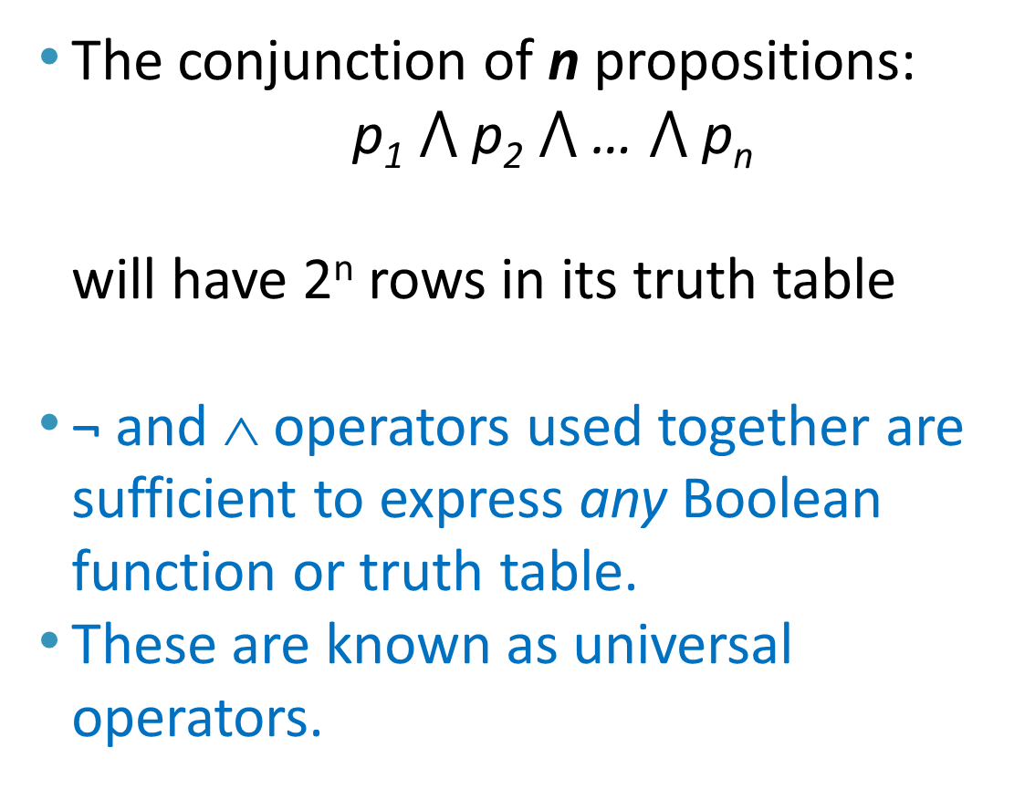
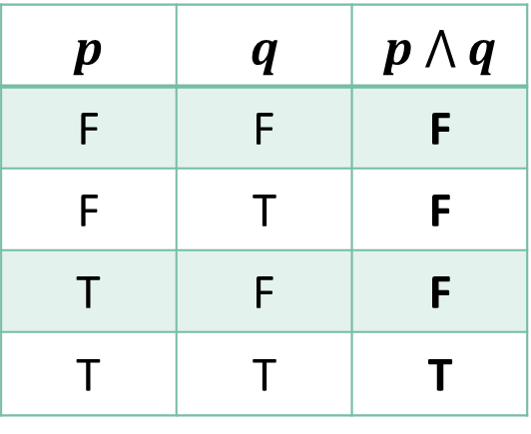
The Conjunction Operator (AND) “∧” – Truth Table
The conjunction of n propositions:
  p₁ $⋀$ p₂ $⋀$ … $⋀$ p_{n}
  will have 2^{n} rows in its truth table
¬ and ∧ operators used together are sufficient to express any Boolean function or truth table.
These are known as universal operators.
p | q | p $⋀$ q
F | F | F
F | T | F
T | F | F
T | T | T

Slide 19
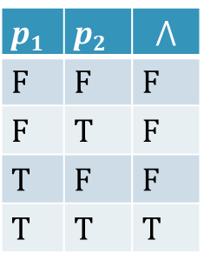
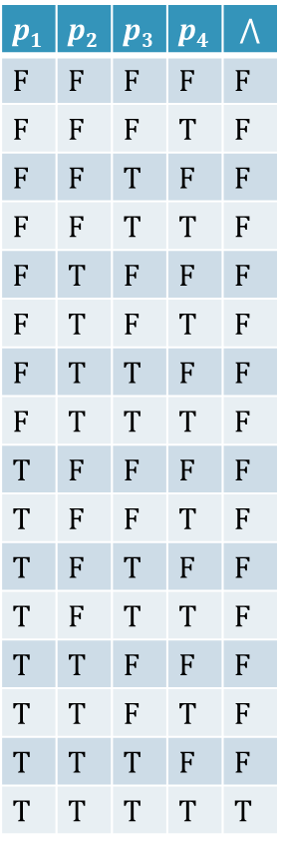
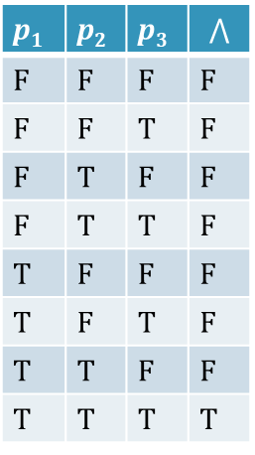
Conjunction Truth Table Examples
p₁ | p₂ | p₃ | p₄ | $$⋀$$
F | F | F | F | F
F | F | F | T | F
F | F | T | F | F
F | F | T | T | F
F | T | F | F | F
F | T | F | T | F
F | T | T | F | F
F | T | T | T | F
T | F | F | F | F
T | F | F | T | F
T | F | T | F | F
T | F | T | T | F
T | T | F | F | F
T | T | F | T | F
T | T | T | F | F
T | T | T | T | T
p₁ | p₂ | p₃ | $$⋀$$
F | F | F | F
F | F | T | F
F | T | F | F
F | T | T | F
T | F | F | F
T | F | T | F
T | T | F | F
T | T | T | T
p₁ | p₂ | $$⋀$$
F | F | F
F | T | F
T | F | F
T | T | T
# rows = 2⁴ = 16
# rows = 2² = 4
# rows = 2³ = 8
Generally, # rows = 2^{n}, where n is the number of propositions

Slide 20
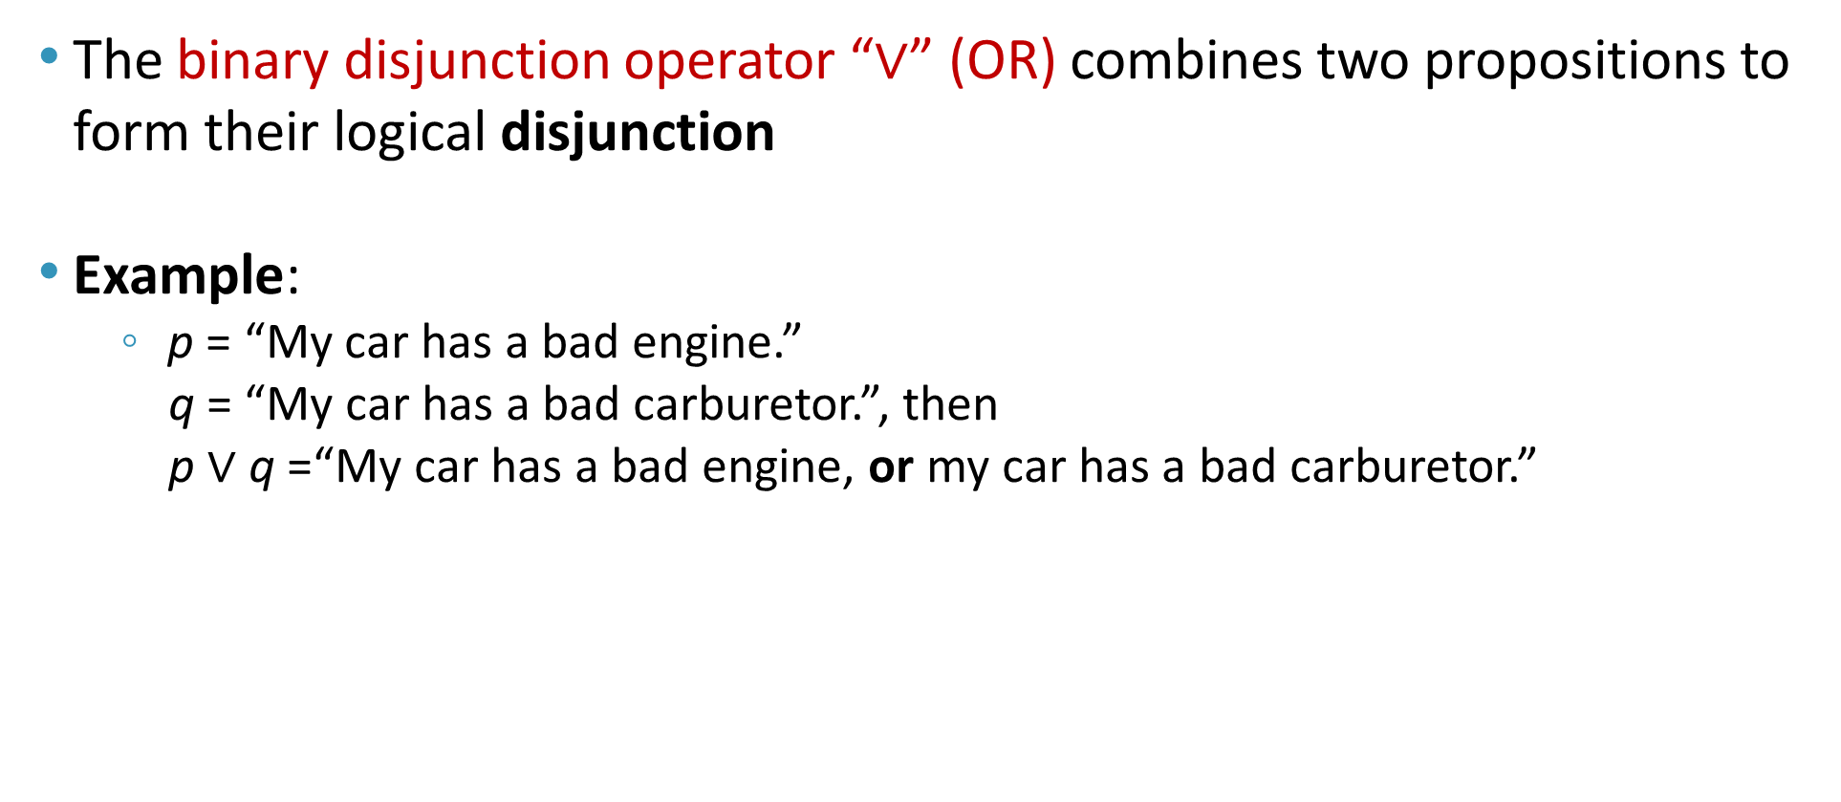
The Disjunction Operator (OR) “∨”
The binary disjunction operator “∨” (OR) combines two propositions to form their logical disjunction
Example:
    p = “My car has a bad engine.”
    q = “My car has a bad carburetor.”, then
    p $∨$ q =“My car has a bad engine, or my car has a bad carburetor.”

Slide 21
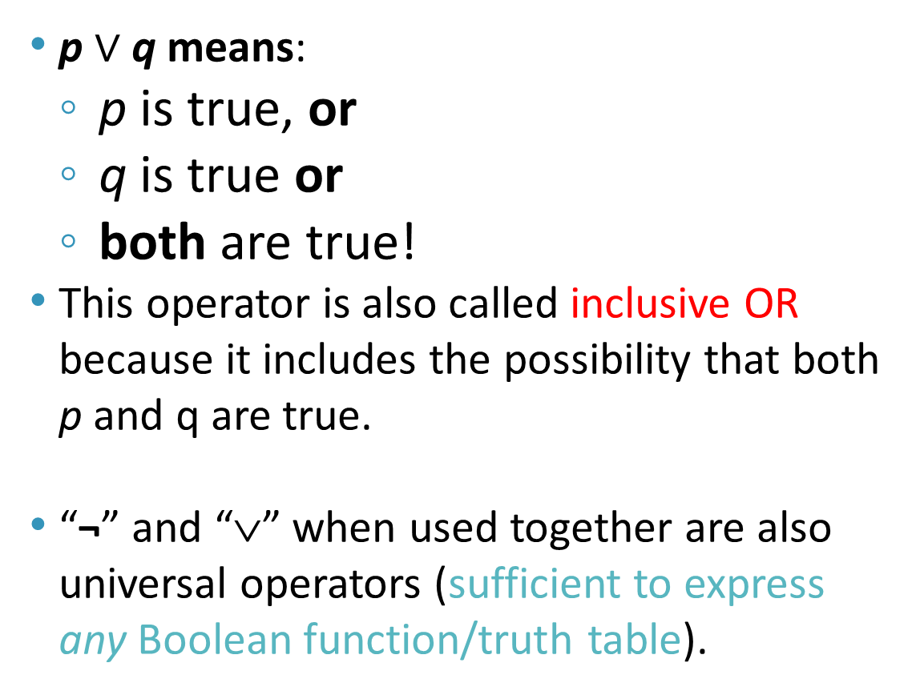
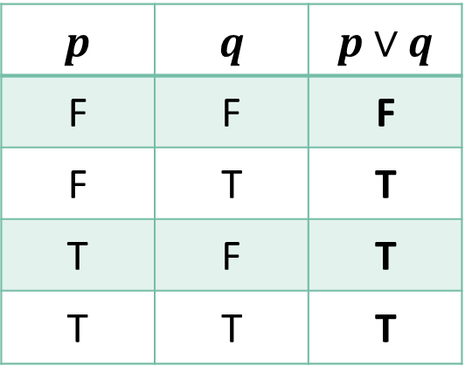
The Disjunction Operator (OR) “∨” – Truth Table
p $∨$ q means:
  p is true, or
  q is true or
  both are true!
This operator is also called inclusive OR because it includes the possibility that both p and q are true.
“¬” and “∨” when used together are also universal operators (sufficient to express any Boolean function/truth table).
p | q | p$∨$ q
F | F | F
F | T | T
T | F | T
T | T | T

Slide 22

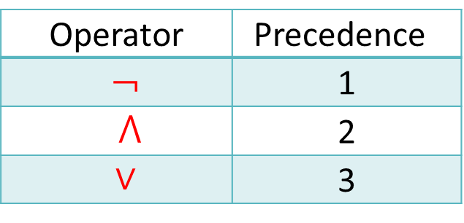
Nested Propositional Expressions
A nested propositional expression is constructed using several propositions connected with the operators: AND, OR, NOT
where parentheses are used to group sub-expressions
  Example:
    f $V$ (g $⋀$ s) is a proposition that would mean something different than (f $V$ g) $⋀$ s
    f ∨ g $⋀$ s would be ambiguous (if operator precedence rules are not used)
By convention, the “¬” operator has precedence over both “∧” and “∨” operators:
    ¬s ∧ f means (¬s) ∧ f but not ¬ (s ∧ f)
Operator | Precedence
¬ | 1
$⋀$ | 2
∨ | 3

Slide 23
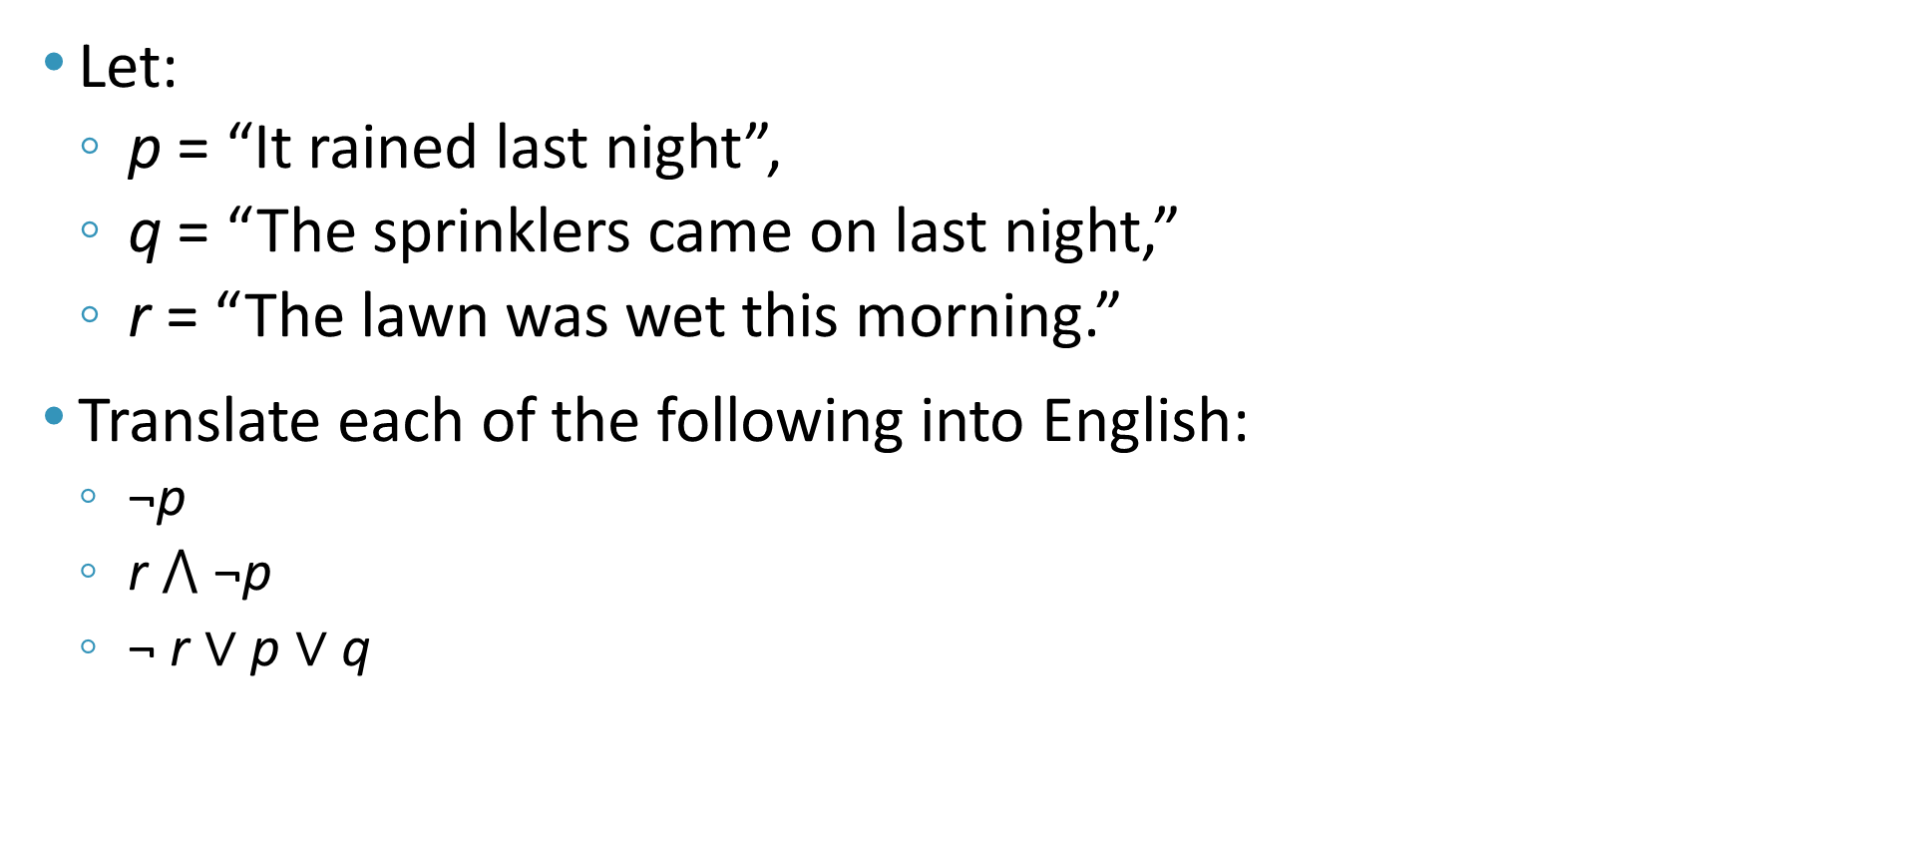
Propositional Expressions - Examples
Let:
  p = “It rained last night”,
  q = “The sprinklers came on last night,”
  r = “The lawn was wet this morning.”
Translate each of the following into English:
  ¬p
  r $⋀$ ¬p
  ¬ r ∨ p ∨ q
= “It did not rain last night.”
= “The lawn was wet this morning, and it did not rain last night.”
= “The lawn was not wet this morning, or it rained last night, or the sprinklers came on last night.”

Slide 24
The Exclusive Disjunction Operator (XOR) “⊕”
The binary exclusive-or operator “⊕” (XOR) combines two propositions to form their logical “exclusive or”
  p = “I will earn an A+ in this course,”
  q = “I will drop this course,” then
  p ⊕ q =
  “I will either earn an A+ in this course,
  or I will drop it
  (but not both!)”

Slide 25
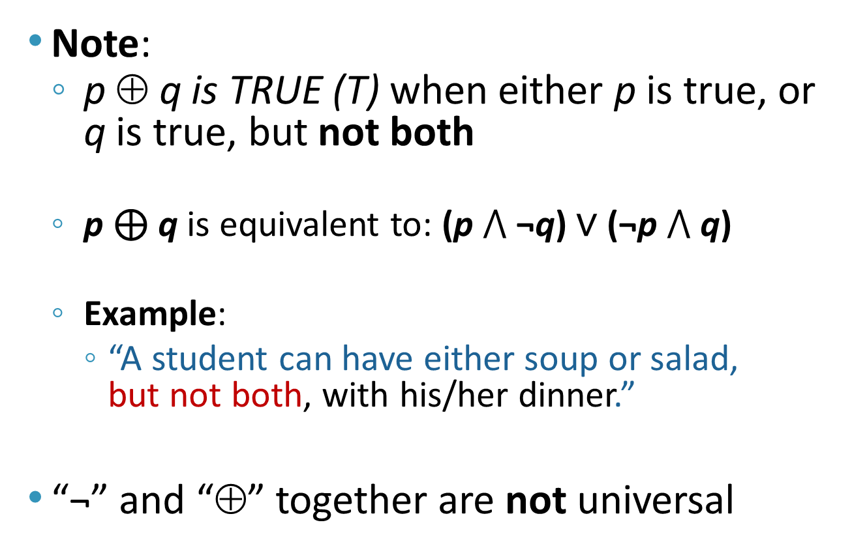
The Exclusive Disjunction Operator (XOR) “⊕” - Truth Table
Note:
  p ⊕ q is TRUE (T) when either p is true, or q is true, but not both
  p ⊕ q is equivalent to: (p $⋀$ ¬q) ∨ (¬p $⋀$ q)
  Example:
    “A student can have either soup or salad,
    but not both, with his/her dinner.”
“¬” and “⊕” together are not universal
p | q | p ⊕ q
F | F | F
F | T | T
T | F | T
T | T | F

Slide 26
Inclusive OR “∨” vs. Exclusive OR “⊕”
Note that the English “OR” can be ambiguous regarding the “both” case!
“Noor is a teacher or Noor is a writer.” ∨
“Noor is a man or Noor is a woman.” ⊕
Need context to disambiguate the meaning!
For this course, assume “or” means inclusive. i.e. either one, or both propositions can be true
p | q | p "OR" q
F | F | F
F | T | T
T | F | T
T | T | ?

Slide 27
The Implication Operator (implies) “→”
The implication p → q states that p implies q, i.e.,
  if p is true, then q is true;
  but, if p is not true, then q could be either true or false
Example
  Let p = “You study hard.”,
  q = “You will get a good grade.”
  p → q = “If you study hard, then you will get a good grade.” (else, it could go either way)
antecedent
consequent

Slide 28
The Implication Operator (implies) “→”
The truth table of the implication operator is shown below
  p → q is false only when
  p is true but q is not true.
  p → q does not say
  that p causes q
  p → q does not require
  that p or q are ever true!
  p → q is equivalent to p ⊆ q
p | q | p → q
F | F | T
F | T | T
T | F | F
T | T | T
The only
False case!

Slide 29
The Implication Operator (implies) “→”
Examples of Implications
  If this lecture ever ends, then the sun will rise tomorrow.” [True]
  “If Tuesday is a day of the week, then I am a penguin.” [False]
  “If the moon is made of green cheese, then I am richer than Bill Gates.” [True]
p | q | p → q
F | F | T
F | T | T
T | F | F
T | T | T

Slide 30
English Phrases for p → q
“p implies q”
“if p, then q”
“if p, q”
“when p, q”
“whenever p, q”
“p only if q”
“p is sufficient for q”
“q is implied by p”
“q if p”
“q when p”
“q whenever p”
“q is necessary for p”
“q follows from p”
p | q | p → q
F | F | T
F | T | T
T | F | F
T | T | T
“p only if q” and “q is necessary for p” mean that p cannot be true when q is not true. That is, the statement is false if p is true, but q is false.

Slide 31
Examples of English uses of Implications
p
q
If you get 100% in the final, you will get an A+
  You get 100% on the final is sufficient to get an A+
  A sufficient condition to get an A+ is to get 100% in the final
  You get an A+ is necessary for you to get 100% on the final (but not sufficient)
  A necessary condition for you to get 100% is you get an A+
  Imagine that you know your letter grade and you are trying to guess your grade in the final:
    If you did not get A+ then for sure you didn't get 100%
    If you get A+ then you may or may not get 100%

Slide 32
Examples of English uses of Implications
If you show up on Monday, you will get the job
  You show up on Monday is sufficient for you to get the job
  A sufficient condition for you to get the job is to show up on Monday
  You get the job is necessary for you to show up on Monday
  A necessary condition for you to show up on Monday is you get the job

Slide 33
Examples of English uses of Implications
You walk 8 miles is necessary to get to the top
  Which of the following statements is equivalent?
    If you walk 8 miles, then you get to the top
    If you got to the top, then you have walked 8 miles
  The first statement is not equivalent, WHY?
    Suppose you walked 8 miles in the wrong direction!
    But if you got to the top then you are sure that you must have walked 8 miles.

Slide 34
Converse, Inverse, Contrapositive
The inverse of p → q is ¬p → ¬q
The converse of p → q is q → p
The contrapositive of p → q is ¬q → ¬p (if not q then not p)
One of these three has the same meaning (same truth table) as p → q. Can you figure out which?
  The contrapositive: ¬q → ¬p
    the contrapositive is false only when ¬p is false and ¬q is true, that is, only when p is true and q is false

Slide 35
Proving Equivalence between p → q and ¬q → ¬p
p | q
F | F
F | T
T | F
T | T
¬p
T
T
F
F
¬q
T
F
T
F
p → q
T
T
F
T
¬q → ¬p
T
T
F
T
p | q | p → q
F | F | T
F | T | T
T | F | F
T | T | T
A conditional statement is logically equivalent to its contrapositive

Slide 36
Converse, Inverse, Contrapositive - Example
Find the contrapositive, the converse, and the inverse of the conditional statement “The home team wins whenever it is raining.”
  Rewrite the statement as “If it is raining, then the home team wins.”
  The inverse (¬p → ¬q):
    “If it is not raining, then the home team does not win.”
  The converse (q → p):
    “If the home team wins, then it is raining.”
  The contrapositive (¬q → ¬p) :
    “If the home team does not win, then it is not raining.”

Slide 37
The Biconditional Operator “↔”
The biconditional p ↔ q states that p is true if and only if (IFF) q is true
Example:
  p = “Ali wins the club election.”
  q = “Ali will be the president of the club for this year.”
  p ↔ q = “If, and only if, Ali wins the club election, Ali will be the president of the club for this year.”

Slide 38
The Biconditional Operator “↔” - Truth Table
p ↔ q means that p and q have the same truth value
  p → q is equivalent to p ⊆ q
  q → p is equivalent to q ⊆ p
  Thus, q ≡ p
Note this truth table is the exact opposite of ⊕’s!
  Thus, p ↔ q means ¬(p ⊕ q)
p ↔ q does not imply that p and q are true, or that either of them causes the other, or that they have a common cause.
p | q | p ↔ q
F | F | T
F | T | F
T | F | F
T | T | T

Slide 39
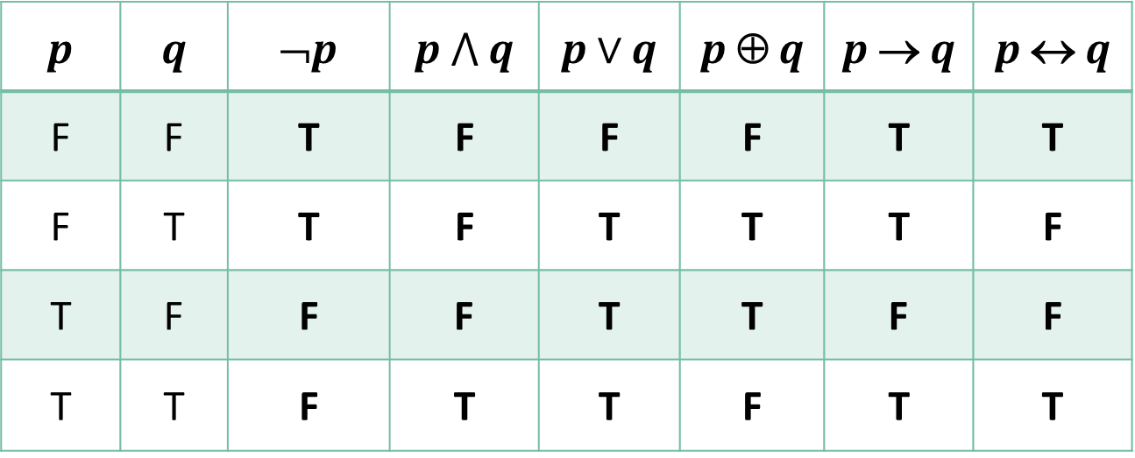
Boolean Operations Summary
p | q | ¬p | p $⋀$ q | p$∨$ q | p ⊕ q | p → q | p ↔ q
F | F | T | F | F | F | T | T
F | T | T | F | T | T | T | F
T | F | F | F | T | T | F | F
T | T | F | T | T | F | T | T

Slide 40
Boolean Operations Alternative Notations
Name | not | and | or | xor | implies | iff
Propositional logic | ¬ | ∧ | ∨ | ⊕ | → | ↔
Boolean algebra |  | p.q (pq) | + | ⊕
C/C++/Java (wordwise) | ! | && | || | != |  | ==
C/C++/Java (bitwise) | ~ | & | | | ^
Logic gates
Python (logical operator) | not | and | or | != |  | ==

Slide 41
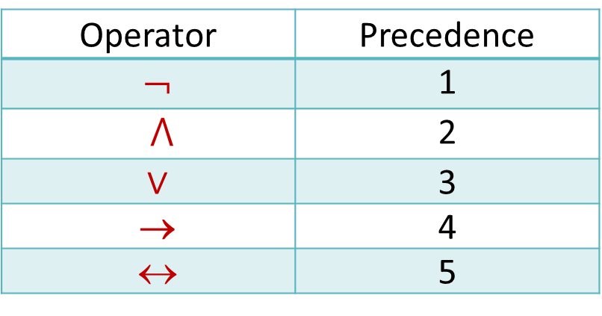
Precedence of Logical Operators
p ∨ q → ¬r is equivalent to (p ∨ q) → ¬r
If the intended meaning is p ∨ (q → ¬r ) then parentheses must be used.
Operator | Precedence
¬ | 1
$⋀$ | 2
∨ | 3
→ | 4
↔ | 5

Slide 42
Tautologies, Contradictions and Contingencies
A tautology is a proposition which is always True
  Example: p ∨ ¬p
A contradiction is a proposition which is always False
  Example: p ∧ ¬p
A contingency is a proposition which is neither a tautology nor a contradiction

Slide 43
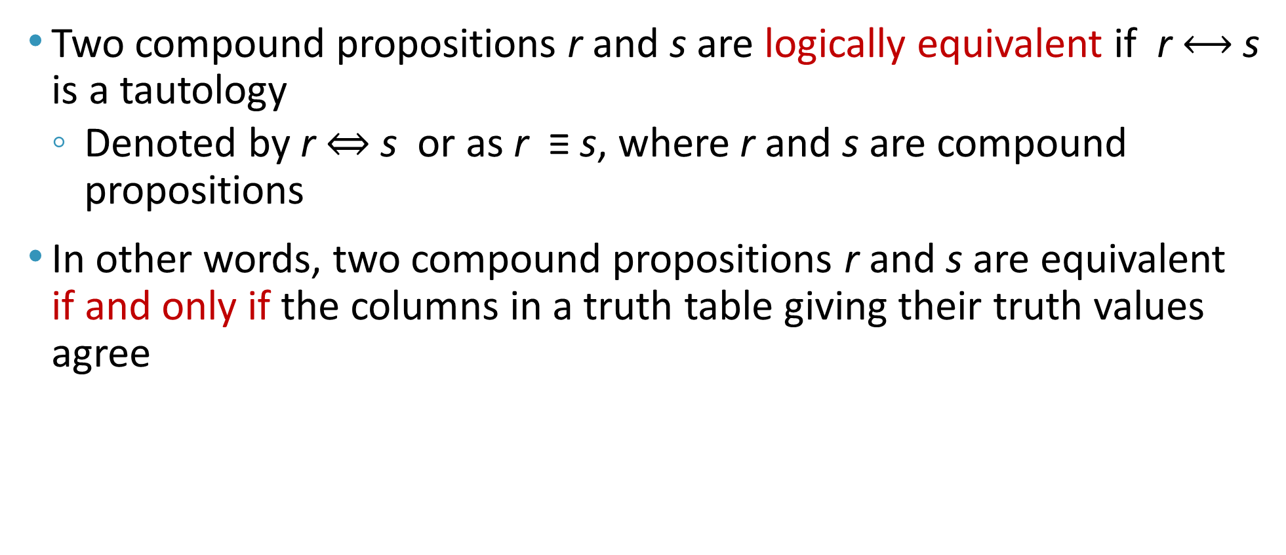
Logically Equivalent
Two compound propositions r and s are logically equivalent if r $⟷$s is a tautology
  Denoted by r ⇔ s or as r ≡ s, where r and s are compound propositions
In other words, two compound propositions r and s are equivalent if and only if the columns in a truth table giving their truth values agree

Slide 44
Logical Equivalence
The following truth table shows r : ¬p ∨ q is equivalent to s: p → q (and s is Equivalent to r)
p | q
F | F
F | T
T | F
T | T
¬p
T
T
F
F
¬p ∨ q
T
T
F
T
p → q
T
T
F
T

Slide 45
De Morgan’s Laws
¬(p ∧ q) ≡ ¬p ∨ ¬q, [first law]
¬(p ∨ q) ≡ ¬p ∧ ¬q, [second law]
¬p ∨ ¬q ≡ ¬(p ∧ q)
¬p ∧ ¬q ≡ ¬(p ∨ q)
p | q | ¬p | ¬q | (p ∨q)
F | F | T | T | F
F | T | T | F | T
T | F | F | T | T
T | T | F | F | T
¬(p ∨q)
T
F
F
F
¬p ∧¬q
T
F
F
F

Slide 46
De Morgan’s Laws
When applying De Morgan’s laws on compound propositional expressions, make sure to put brackets first around conjunctive operators
Example:
  ¬(p ∧ q V r ∧ s)
  ≡ ¬((p ∧ q) V (r ∧ s))
  ≡ ¬(p ∧ q) ∧ ¬ (r ∧ s)
  ≡ (¬p V ¬q) ∧ (¬r V ¬s)

Slide 47
Rules of Inference
Proof: valid arguments that establish the truth of a mathematical statement
Argument: a sequence of statements that end with a conclusion
Valid: the conclusion or final statement of the argument must follow the truth of preceding statements or premises of the argument

Slide 48
Argument and Inference
An argument is valid if and only if it is impossible for all the premises to be true and the conclusion to be false
Rules of inference: used to deduce (construct) new statements from statements that we already have
  Basic tools for establishing the truth of statements

Slide 49
Valid Arguments in Propositional Logic
Consider the following arguments involving propositions
“If you have a current password,
then you can login to the network”
“You have a current password”
therefore,
“You can login to the network”
p
p → q
q
p
premises
∴
conclusion
q
p → q
p
______
∴ q
p
p → q
______
∴ q

Slide 50
Valid Arguments
p
p → q
______
∴ q
(p ∧ (p → q)) → q is a tautology (always true)
p | q
F | F
F | T
T | F
T | T
p → q
T
T
F
T
p ∧ (p → q)
F
F
F
T
(p ∧ (p → q)) → q
T
T
T
T
∴ therefore
This is another way of saying that

Slide 51
Rules of Inference for Propositional Logic
Can always use truth table to show an argument form is valid
For an argument form with 10 propositional variables, the truth table requires 2¹⁰ rows (1024)
The tautology (p ∧ (p → q)) → q is the rule of inference called modus ponens (mode that affirms), or the law of detachment
Argument form: a sequence of compound propositions involving propositional variables
p
p → q
______
∴ q

Slide 52
Example
If both statements
  “If it snows today, then we will go skiing”
  “It is snowing today”
are true
By modus ponens,
  it follows the conclusion
    “We will go skiing”
    is true
p → q
p
p
p → q
______
∴ q
q

Slide 53
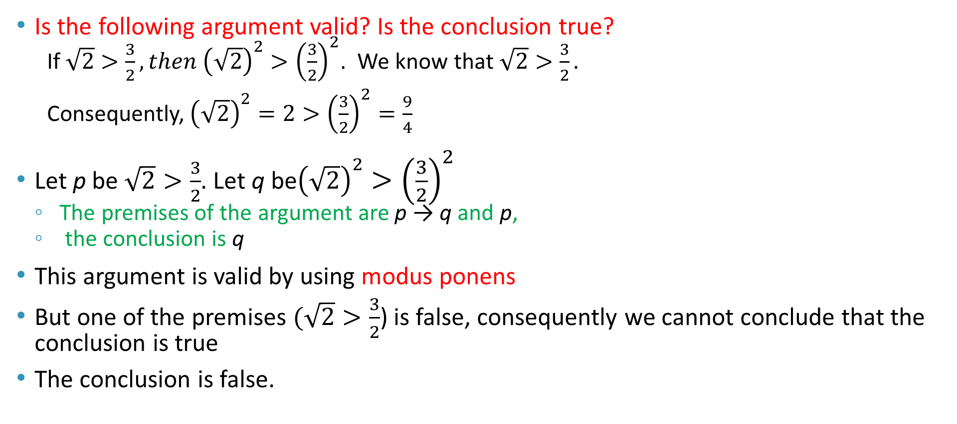
Example
Is the following argument valid? Is the conclusion true?
  If $\sqrt{2}>\frac{3}{2}, then {\left(\sqrt{2}\right)}^{2}>{\left(\frac{3}{2}\right)}^{2}$. We know that $\sqrt{2}>\frac{3}{2}.$
  Consequently, ${\left(\sqrt{2}\right)}^{2}=2>{\left(\frac{3}{2}\right)}^{2}=\frac{9}{4}$
Let p be $\sqrt{2}>\frac{3}{2}$. Let q be${\left(\sqrt{2}\right)}^{2}>{\left(\frac{3}{2}\right)}^{2}$
  The premises of the argument are p → q and p,
  the conclusion is q
This argument is valid by using modus ponens
But one of the premises $(\sqrt{2}>\frac{3}{2}$) is false, consequently we cannot conclude that the conclusion is true
The conclusion is false.
p → q
p
______
∴ q

Slide 54
Rules of Inference
Means to draw conclusions from other assertions
Rules of inference provide justification of steps used to show that a conclusion follows from a set of hypotheses (premises)
The next several slides illustrate specific rules of inference

Slide 55
Addition
A true hypothesis implies that the disjunction
of that hypothesis and another are true
p
_______
∴ p ∨ q
or p → (p ∨ q)

Slide 56
Simplification
If the conjunction of 2 propositions is true,
then each proposition is true
p ∧ q
_______
∴ p
or (p ∧ q) → p
p ∧ q
_______
∴ q
Also (p ∧ q) → q

Slide 57
Conjunction
If p is true and q is true, then p ∧ q is true
p
q
_______
∴ p ∧ q
or ((p) ∧ (q)) → p ∧ q

Slide 58
Modus Ponens
If a hypothesis and implication are both true,
then the conclusion is true
p
p → q
_______
∴ q
or (p ∧ (p → q)) → q

Slide 59
Modus Tollens
If a conclusion is false and its implication
is true, then the hypothesis must be false
¬q
p → q
_______
∴¬p
or (¬q ∧ (p → q)) → ¬p

Slide 60
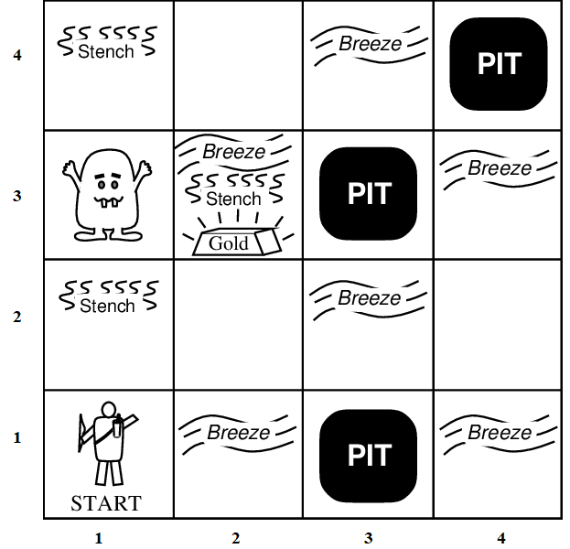
The Wumpus World Example
  The Wumpus world is a cave with 16 rooms (4×4). Each room is connected to other rooms through walkways. No rooms are connected diagonally.
  The knowledge-based agent starts from room [1, 1]. The cave has some pits, a treasure, and a beast named Wumpus.
  The Wumpus cannot move but eats the one who enters its room, and if the agent enters the pit, it gets stuck there.

Slide 61
The Wumpus World Example
  The goal of the agent is to take the treasure and come out of the cave.
    The agent is rewarded, when the goal conditions are met.
    The agent is penalized, when it falls into a pit or being eaten by the Wumpus.

Slide 62
The Wumpus World Example
Some elements support the agent to explore the cave:
  The Wumpus's adjacent rooms are stenchy (i.e., have bad smell).
  The adjacent rooms of the room with pits are filled with breeze.
  The agent is given one arrow which it can use to kill the Wumpus when facing it (Wumpus screams when it is killed).
  The treasure room is always glittery.
The agent starts with no information of where the pits, Wumpus and the gold are.

Slide 63
The Wumpus World Example
Let’s assign a Utility measure as shown below:
  +1000 for climbing out of the cave with the gold (End),
  -1000 for falling into a pit or being eaten by the Wumpus (End),
  –1 for each action taken, and
  –10 for using up the arrow.
The Environment description:
  In a 4×4 grid of rooms, the agent starts in square [1,1], facing right.
  The gold and the Wumpus locations are randomly chosen uniformly, in any room other than room [1,1].
  Each room other than the start can be a pit, with a probability of 0.2.

Slide 64
The Wumpus World Example
Actuators:
  Left turn
  Right turn
  Move forward
  Move backward
  Grab gold
  Release gold
  Shoot arrow
Sensors:
  Perceive a Stench in the squares containing or adjacent to the Wumpus
  Perceive a Breeze in the squares adjacent to a pit
  Perceive a Glitter in the square where the gold is
  Perceive a Bump when the agent walks into a wall
  Perceive a woeful (i.e. unhappy) Scream anywhere in the caves when the Wumpus is killed
  Perceive “None” if all the adjacent rooms neither have a pit nor a Wumpus

Slide 65
Wumpus World Characterization
Acronyms
  B = Breeze
  A = Agent
  G = Glitter
  OK = Safe room
  P = Pit
  S = Stench
  V = visited the room
  W = Wumpus
Is the Wumpus World | Answer | Why?
Deterministic? | Yes | outcome exactly specified
Observable? | No | only local perception
Static? | Yes | Wumpus and pits do not move
Discrete? | Yes | Wumpus can be in a certain room at a time
Episodic? | No | sequential at the level of actions.

Slide 66
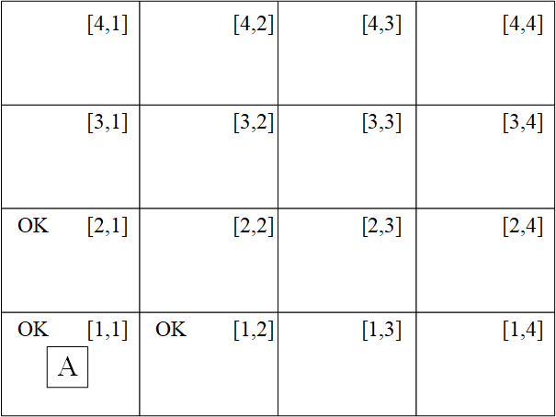
Wumpus World Solution
Step 1:
  Since A does not perceive anything → room [1,1] is OK.
  Since A does not perceive anything in [1,1] → room [1,2] and room [2,1] are OK.
  The agent must choose between room [1,2] and room [2,1]. Since both are okay, he can flip a coin and choose any.
  Suppose he chose room [1,2]

Slide 67
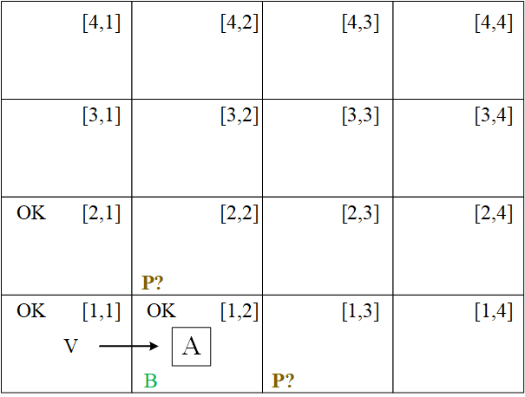
Wumpus World Solution
Step 2:
  A perceives a Breeze in room [1,2] → room [1,3] and [2,2] may have pits
  Action: calculate penalty for each unexplored room and move to least penalty room, i.e. move to [2,1] via room [1,1]
  Anticipated Penalty for room [1,3] = -1000
  Anticipated Penalty for room [2,2] = -1000
  Penalty for room [2,1] via room [1,1] = -2

Slide 68
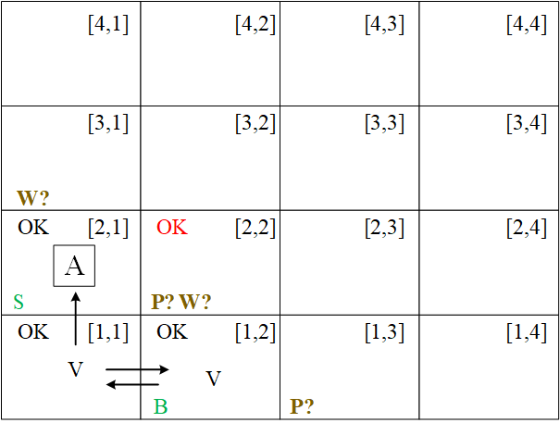
Wumpus World Solution
Step 3:
  A perceives a Stench in room [2,1] → room [3,1] and [2,2] may have Wumpus
  The agent observes a conflict in logic in room [2,2]:
    When A was in room [1,2] there was no stench, thus room [2,2] cannot have Wumpus
    Room [2,1] does not have a breeze and hence there cannot be a pit in room [2,2].
    Therefore, A concludes that room [2,2] is safe and marks it as OK.
  Action Move to room [2,2]

Slide 69
Wumpus World Solution
Step 3:
  Wumpus → Stench
  [1,2] no stench → [2,2] no Wumpus
  Pit → Breeze
  [2,1] no Breeze → [2,2] no Pit
  Thus, [2,2] has no Wumpus and no Pit and is marked OK
  S in [2,1] → W in [3,1] V W in [2,2]
  Since W in [2,2]=F → W in [3,1]=T
  Thus, we conclude that Wumpus is in [3,1]

Slide 70
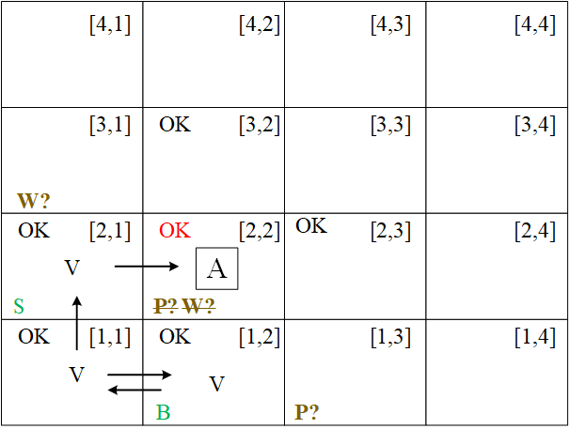
Wumpus World Solution
Step 4:
  A perceives nothing in room [2,2] → Mark room [2,3] and [3,2] as OK
  Choices:
    Move to room [2,3] or [3,2] since they are safe
  Action: move to room [2,3]

Slide 71
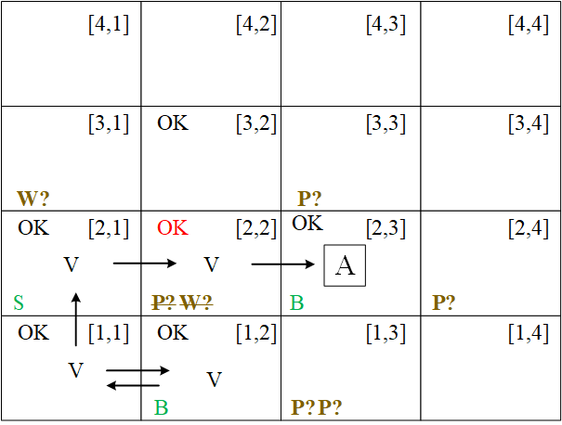
Wumpus World Solution
Step 5:
  A perceives a Breeze in room [2,3] → rooms [3,3] and [2,4] may have pits.
  Action: estimate penalty in each room → move to room [3,2]

Slide 72
Wumpus World Solution
Step 6:
  A perceives a Stench, Breeze and Glitter in room [3,2]→ grab the gold.
Step 7: To get out backtrack your steps by maximizing Utility (or minimizing penalty)
  Backtrack path [3,2] → [2,2] → [2,1] → [1,1]
Try it out: http://primaryobjects.github.io/wumpus/

Slide 73
Conclusion
Knowledge representation plays a big role in an agent's behavior.
We utilize propositional logic and other types of logic for knowledge representation.
Inference logic is needed to infer new knowledge form known knowledge.

